Slide 1

4th Round Affordable Housing Overview
Hopewell Township Committee

Slide 2
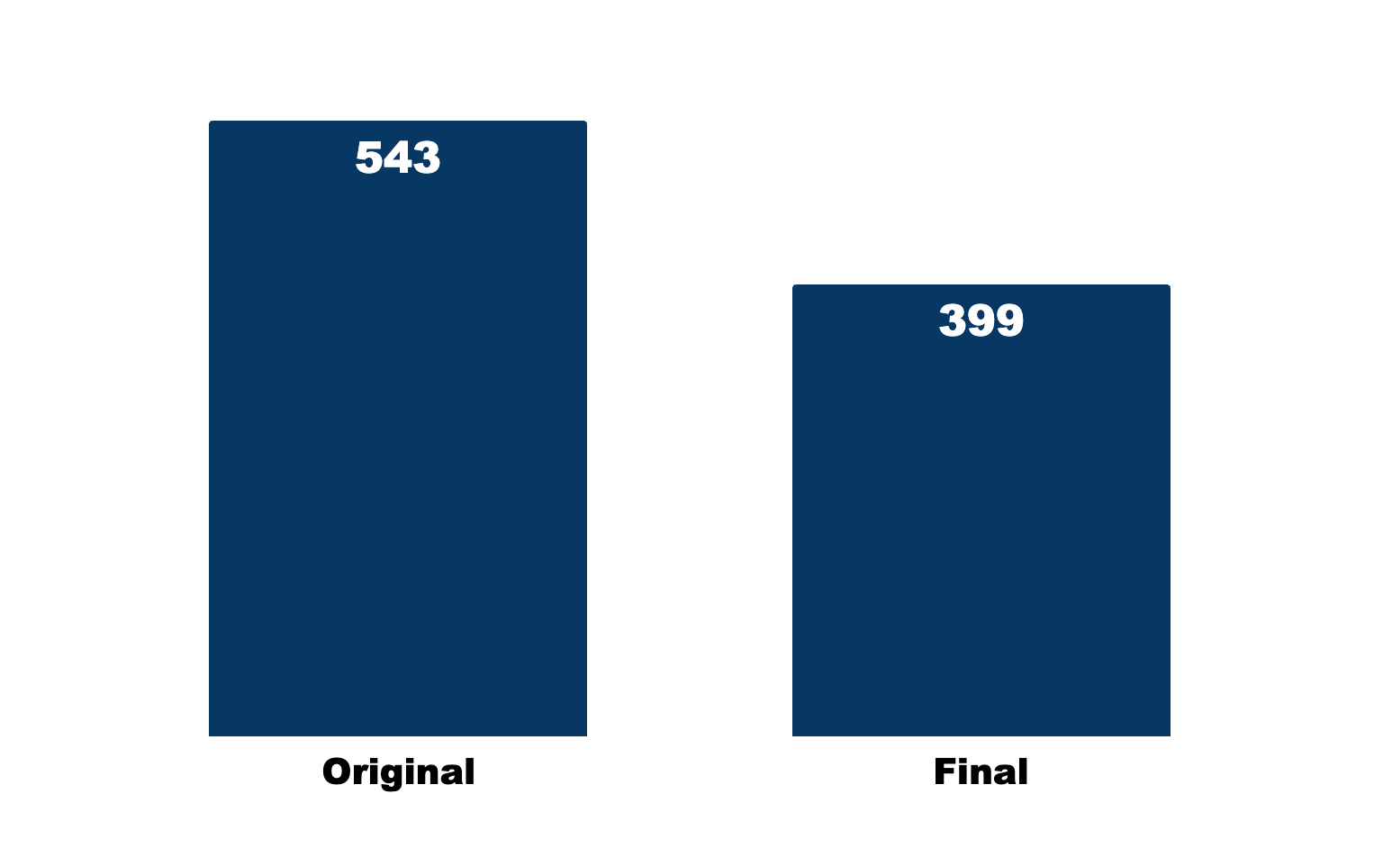
The Hopewell Township Committee successfully reduced 4th Round affordable housing obligation from 543 to 399 units/credits
-27%

Slide 3
Through careful planning, the Hopewell Township Committee reduced the impact of the 399-unit 4th Round obligation.
Renew expiring deed restrictions
Promote 100% affordable projects
Limit inclusionary developments
Leverage bonus credits, including group homes

Slide 4
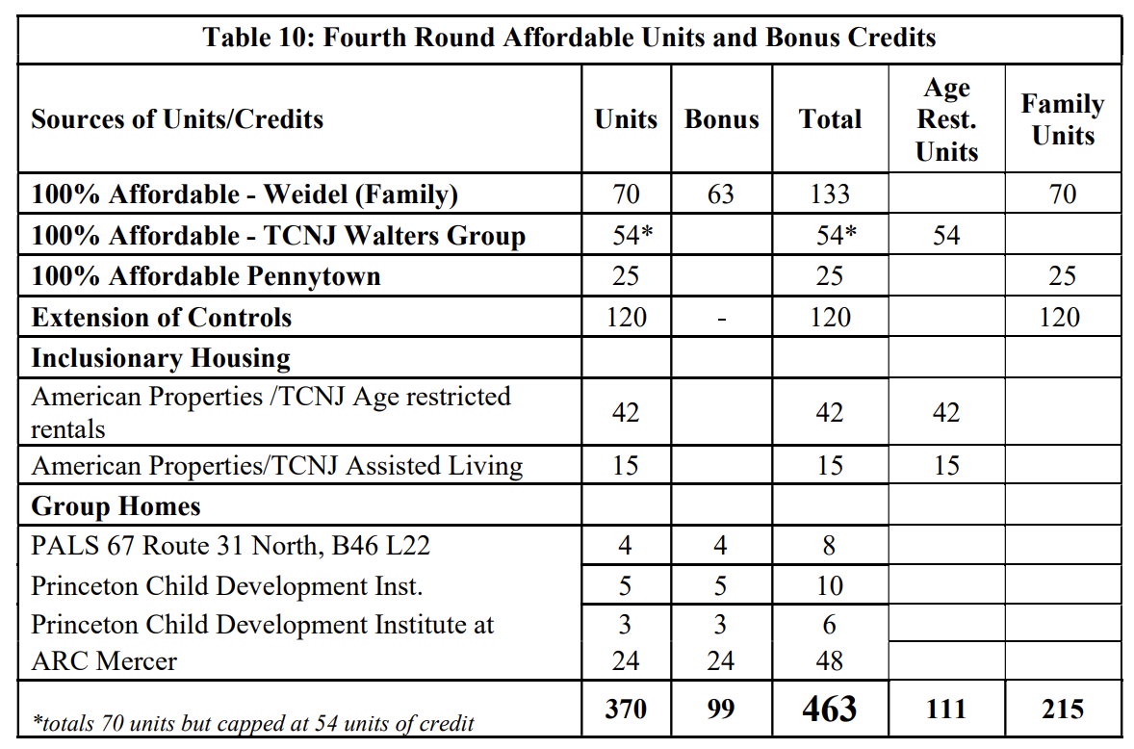
The 4th Round Housing Element and Fair Share Plan puts these reduction strategies into practice
No new units
These homes are already occupied and simply remaining in the program.

Slide 5
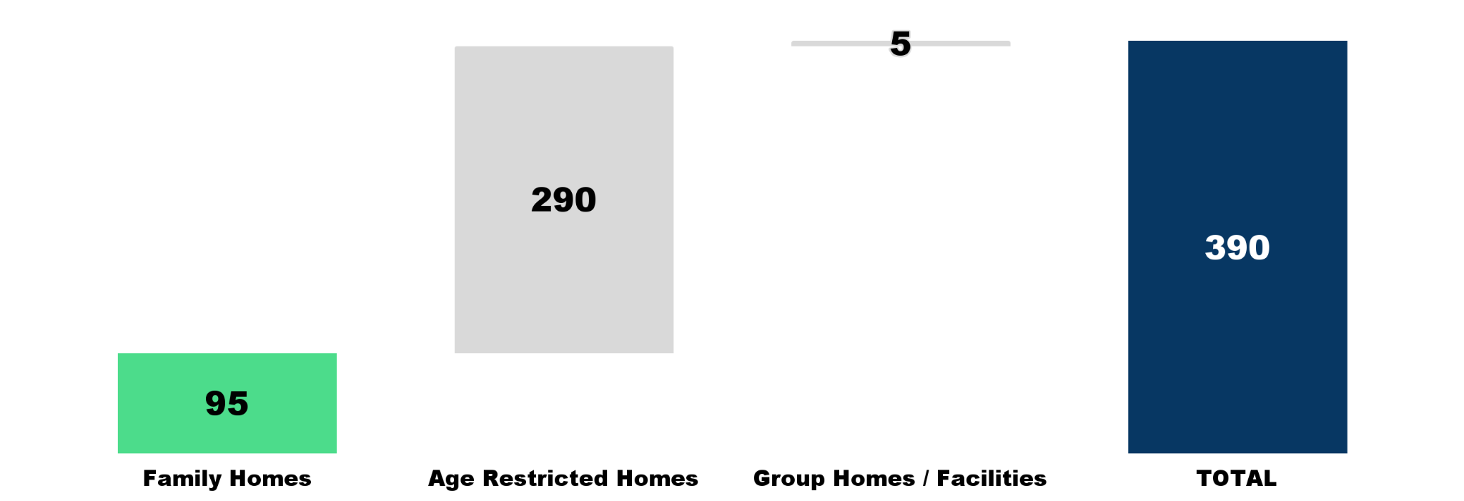
The plan developed by the Hopewell Township Committee includes no more than 95 family homes
New Housing Construction Planned in 4th Round
Defined as Homes or Facilities | By Type
Notes:
Excludes credits, affordability control extensions, and other offsets that are not actually new units to be constructed.
Family Homes (95) includes the Weidel (70) and Pennytown (25) 100% affordable developments
Age Restricted Homes (290) includes the TCNJ Walters Group (70) 100% affordable development and American Properties Age Restricted rentals inclusionary development (42) and assumed 4:1 ratio (210 total)
Group Homes / Facilities (5) includes ARC Mercer Homes (4 homes) which include 24 beds across all and American Properties / TCNJ Assisted Living (1 facility) which will include 120 beds.

Slide 6
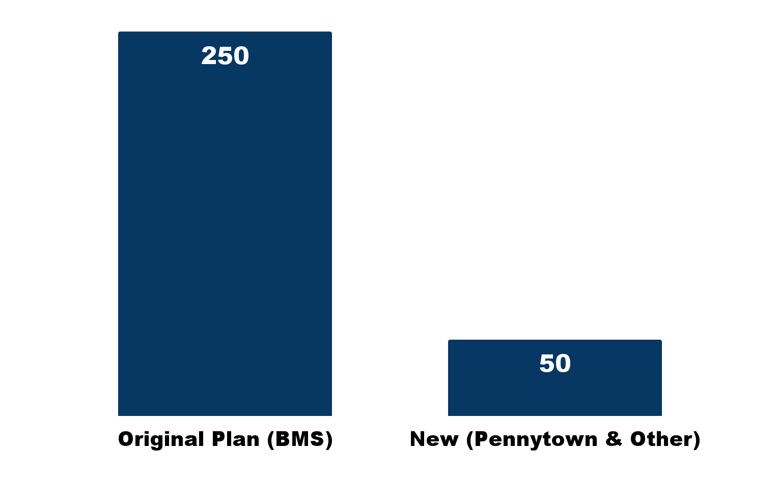
The Township Committee worked to relocate 50 affordable units away from BMS - As a result 200 fewer market rate homes will be built.
By removing 250 planned family homes at the former BMS site in the 3rd Round and adding 95 affordable units in the 4th Round, the net number of family homes—and the potential impact on schools—has been reduced by over 150.

